Slide 1

Slide <number>

Slide 2
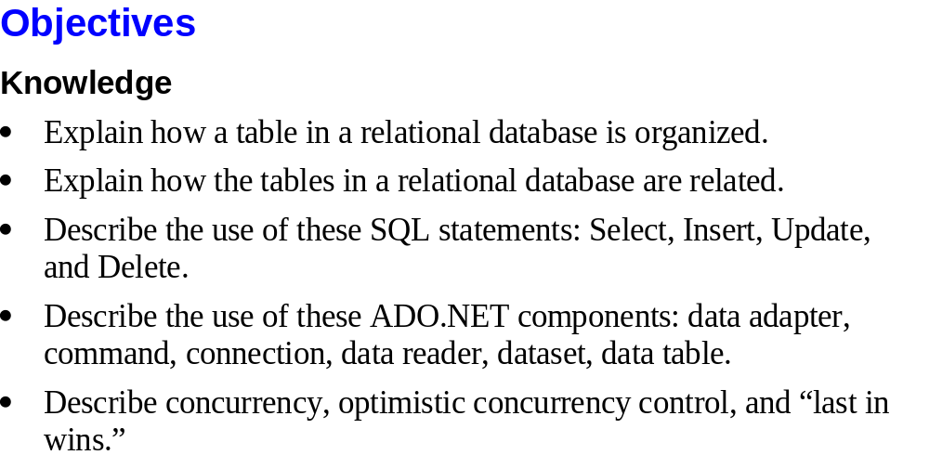
Slide <number>

Slide 3
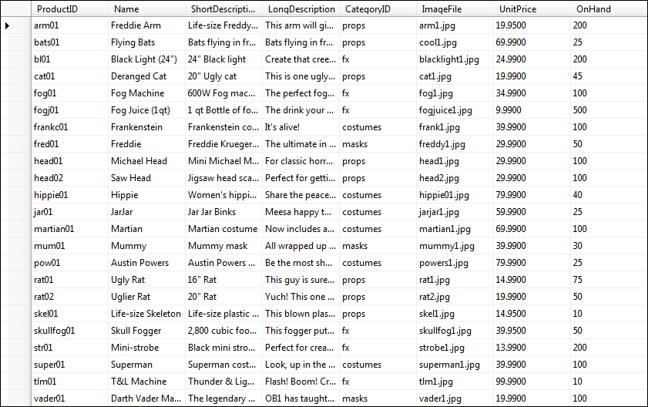
Slide <number>

Slide 4
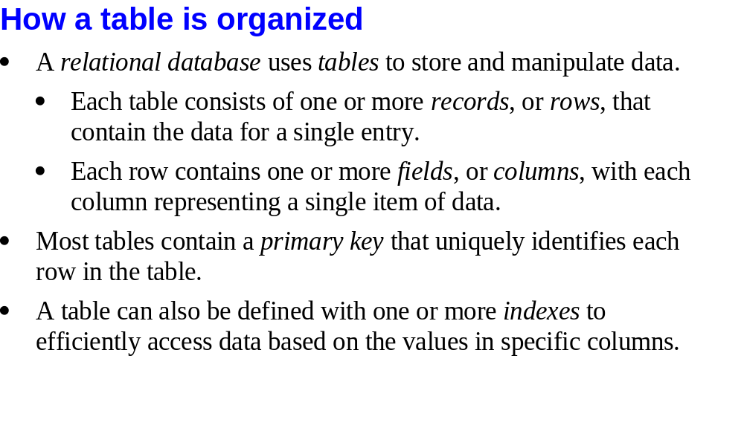
Slide <number>

Slide 5
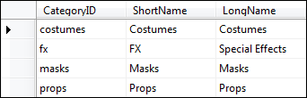
Slide <number>

Slide 6
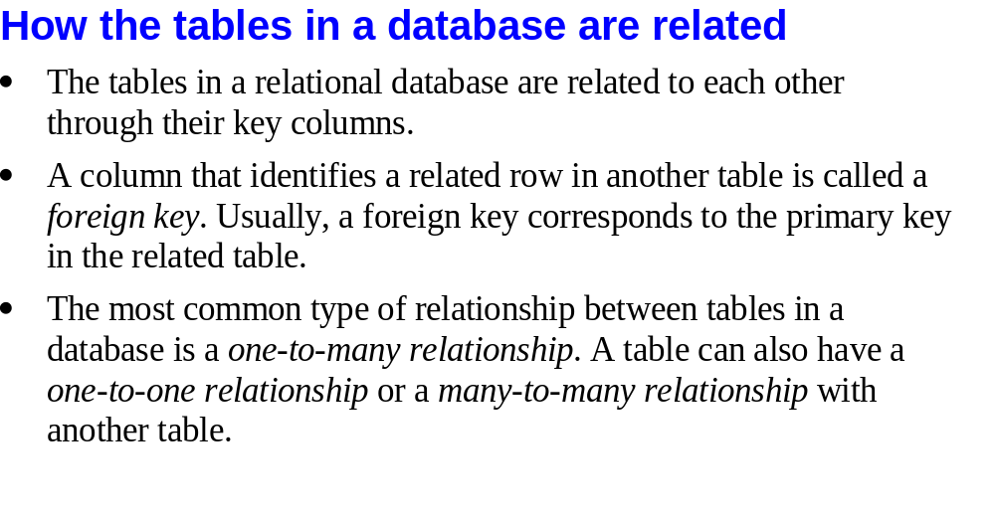
Slide <number>

Slide 7

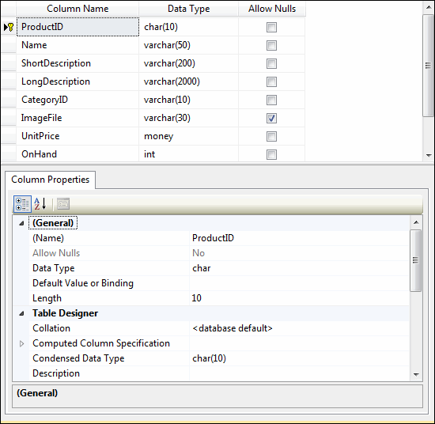
Slide <number>

Slide 8
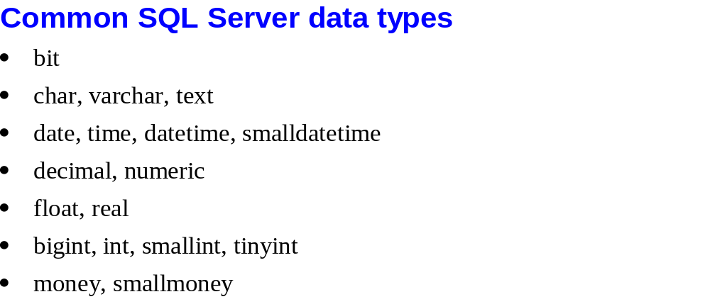
Slide <number>

Slide 9
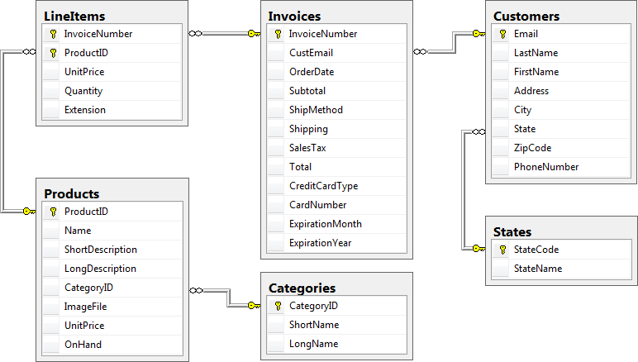
Slide <number>

Slide 10
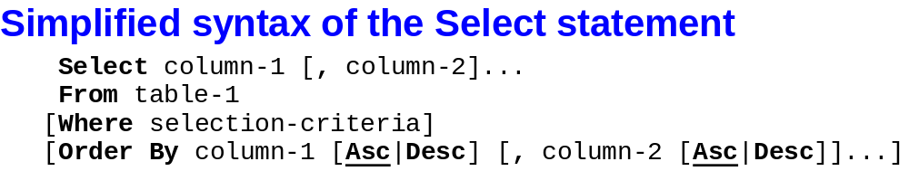
Slide <number>

Slide 11
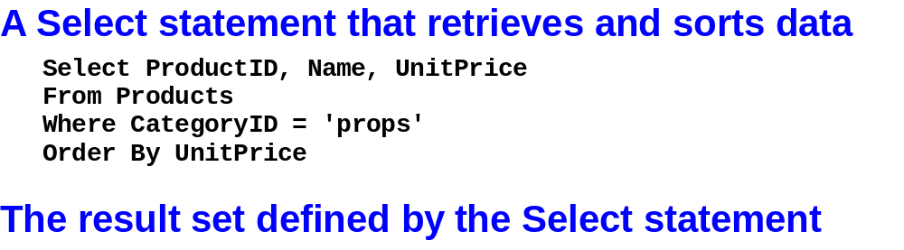
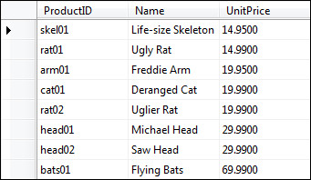
Slide <number>

Slide 12
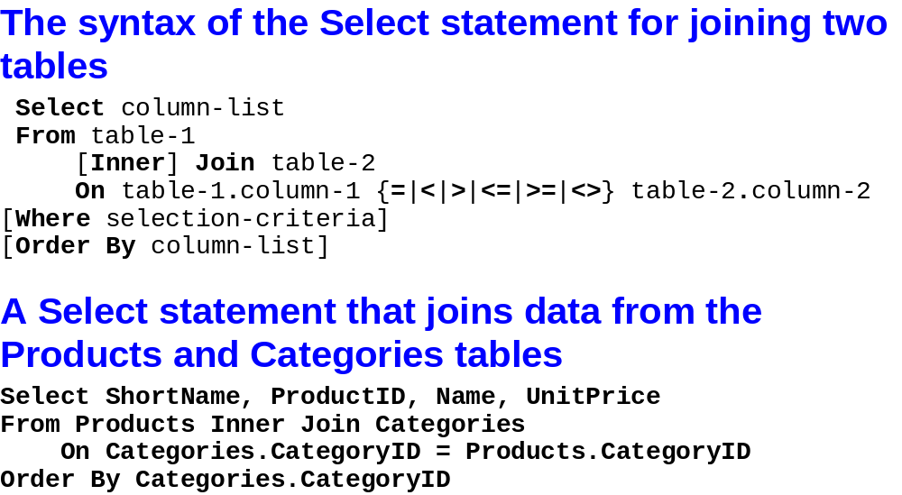
Slide <number>

Slide 13
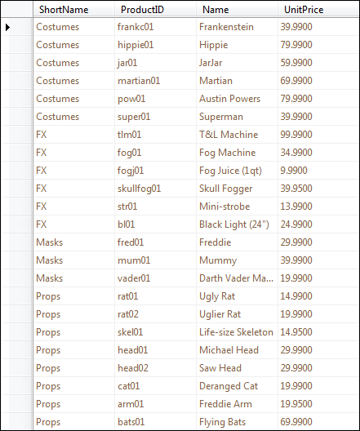
Slide <number>

Slide 14
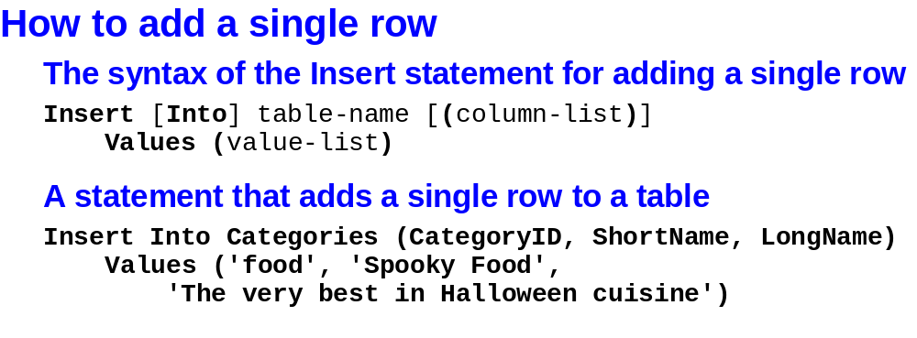
Slide <number>

Slide 15
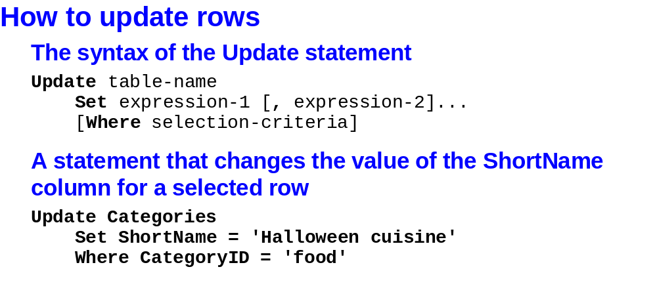
Slide <number>

Slide 16
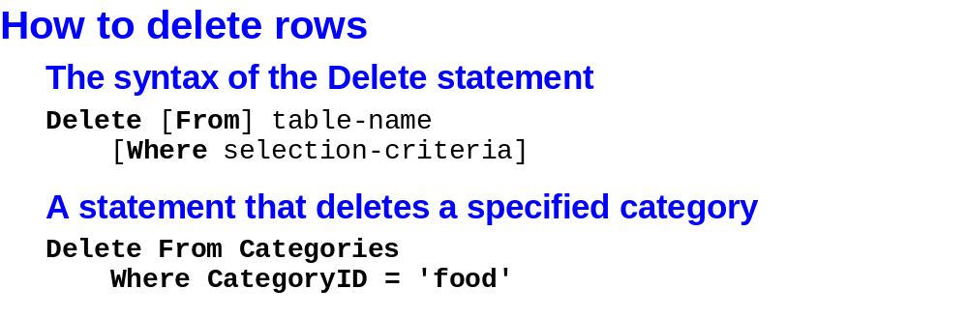
Slide <number>

Slide 17
Installing Sample Databases
Use InstNwnd.sql to install the Northwind database.
Use InstPubs.sql to install the Pubs database.
Slide <number>

Slide 18
Installing Sample Databases
Using a full version of SQL Server, two methods as given below:-
  To install a database by running an SQL script, you simply need to start SQL Server Management Studio, open the SQL file (using the File ➤ Open ➤ File command), and then run it (using the Query ➤ Execute command).
  Type the following command in the command prompt:
      sqlcmd -i InstNwnd.sql
Slide <number>

Slide 19
Installing Sample Databases
To install the Northwind database on SQL Server Express LocalDB
  sqlcmd -S (localdb)\v11.0 -i InstNwnd.sql
Slide <number>

Slide 20
Installing Sample Databases
On the separately downloadable version of SQL Server Express
    sqlcmd -S localhost\SQLEXPRESS -i InstNwnd.sql
Slide <number>

Slide 21
Browsing and Modifying Databases in Visual Studio
The tab for Server Explorer is on the right side of the Visual Studio window, grouped with the Toolbox and collapsed.
  Otherwise, click View ➤ Server Explorer to show it
Connect to existing databases or create new ones by using the Data Connections node in the Server Explorer.
Slide <number>

Slide 22
Creating a connection in Visual Studio
Right-click the Data Connections node and choose Add Connection.
When the Choose Data Source window appears, select Microsoft SQL Server and then click Continue.
Slide <number>

Slide 23
Creating a connection in Visual Studio
If you’re using a full version of SQL Server, enter localhost as your server name. This indicates that the database server is the default instance on the local computer. (Replace this with the name of a remote computer if needed.) SQL Server Express is a bit different. If you’re using SQL Server Express LocalDB (the version that’s included with Visual Studio), you need to enter (localdb)\v11.0 instead of localhost, as shown in Figure 14-2. If you’ve downloaded the full edition of SQL Server Express, you need to enter localhost\SQLEXPRESS instead.
Slide <number>

Slide 24
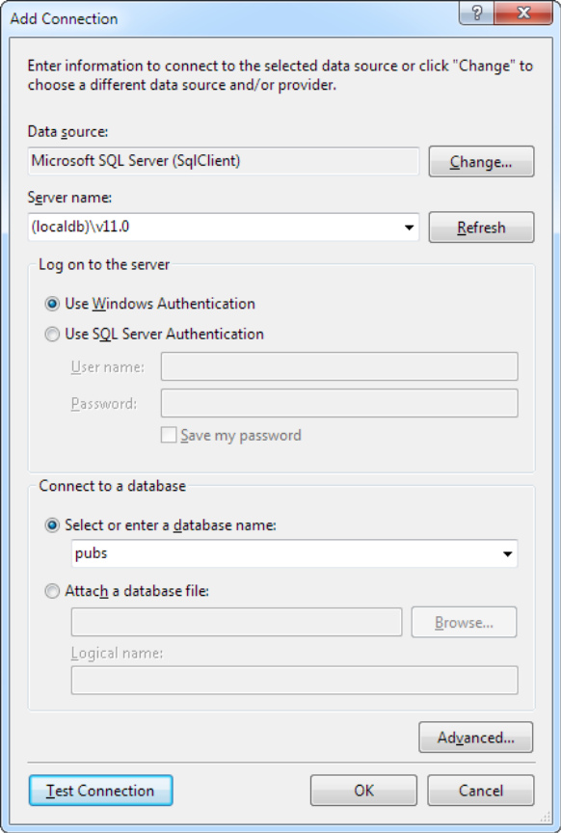
Creating a connection in Visual Studio
Slide <number>

Slide 25
Creating a connection in Visual Studio
Click the Test Connection button to verify that this is the location of your database. If you haven’t installed a database product yet, this step will fail. Otherwise, you’ll know that your database server is installed and running.
In the Select or Enter a Database Name list, choose the pubs database. (In order for this to work, the pubs database must already be installed. You can install it by using the database script that’s included with the sample code, as explained in the following section.) If you want to see more than one database in Visual Studio, you’ll need to add more than one data connection.
Slide <number>

Slide 26
Creating a connection in Visual Studio
Click OK. The database connection appears in the Server Explorer window. You can now explore its groups to see and edit tables, stored procedures, and more. For example, if you right-click a table and choose Show Table Data, you’ll see a grid of records that you can browse and edit, as shown in Figure 14-3.
Slide <number>

Slide 27
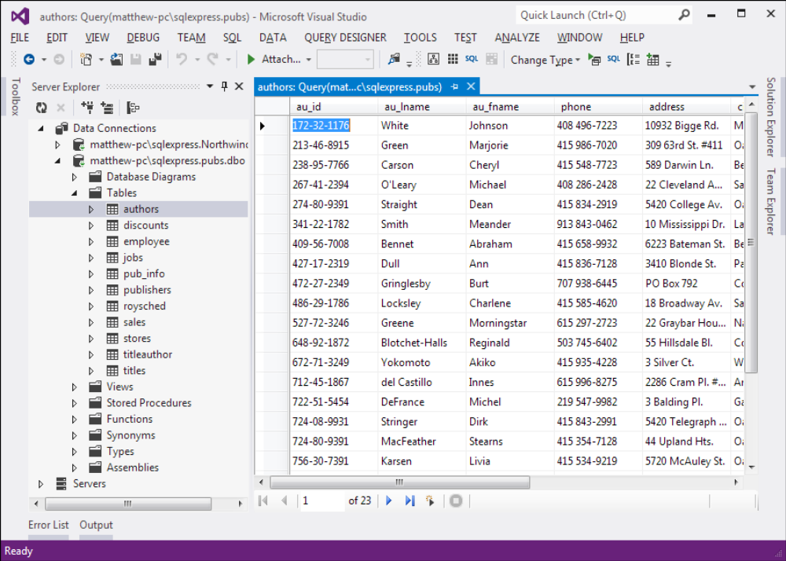
Editing table data in Visual Studio
Slide <number>

Slide 28
Running Queries in Visual Studio
Right-click your connection and choose New Query.
Choose the table (or tables) you want to use in your query from the Add Table dialog box (as shown in Figure 14-5). Click Add and then click Close.
Slide <number>

Slide 29
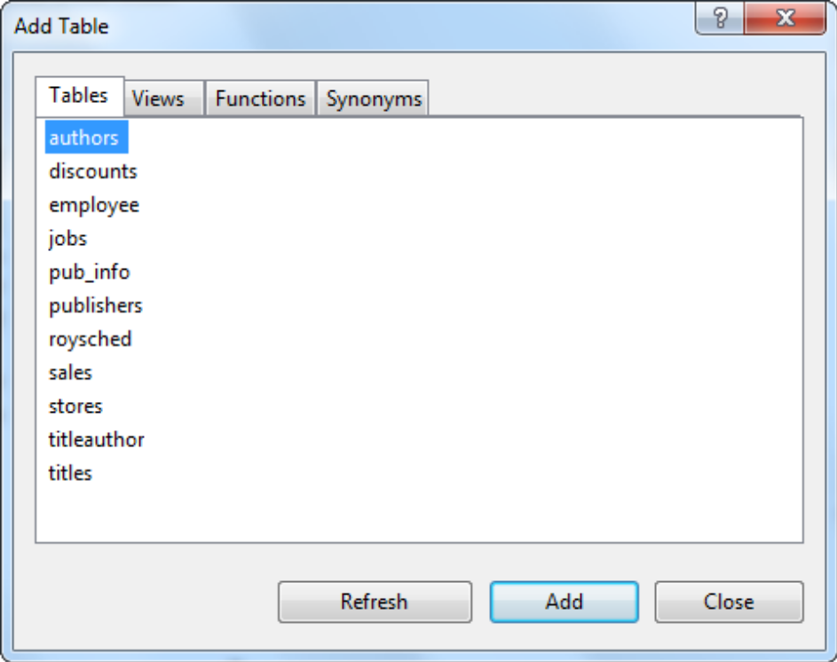
Adding tables to a query
Slide <number>

Slide 30
Running Queries in Visual Studio
create your query by adding check marks next to the fields or edit the SQL by hand in the lower portion of the window
choose Query Designer ➤ Execute SQL from the menu
Slide <number>

Slide 31
Running Queries in Visual Studio
If you’re selecting records, the results will appear at the bottom of the window. If you’re deleting or updating records, a message box will appear, informing you of the number of records affected (see Figure 14-6).
Slide <number>

Slide 32
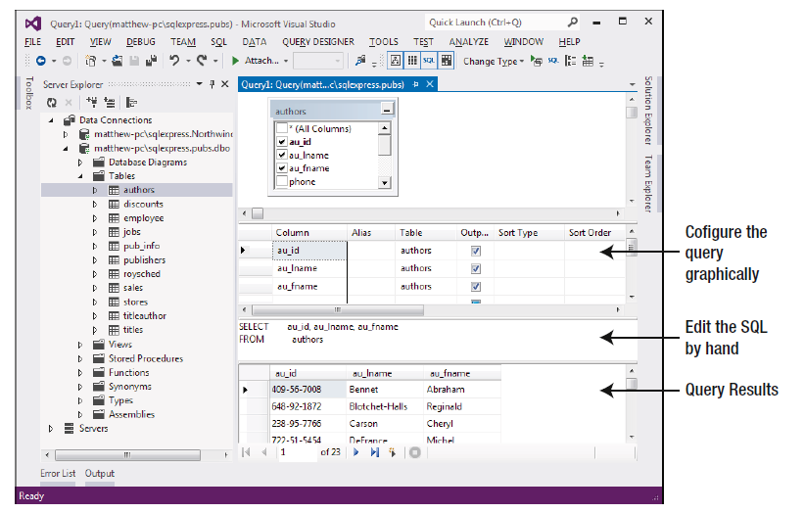
Executing a query
Slide <number>

Slide 33
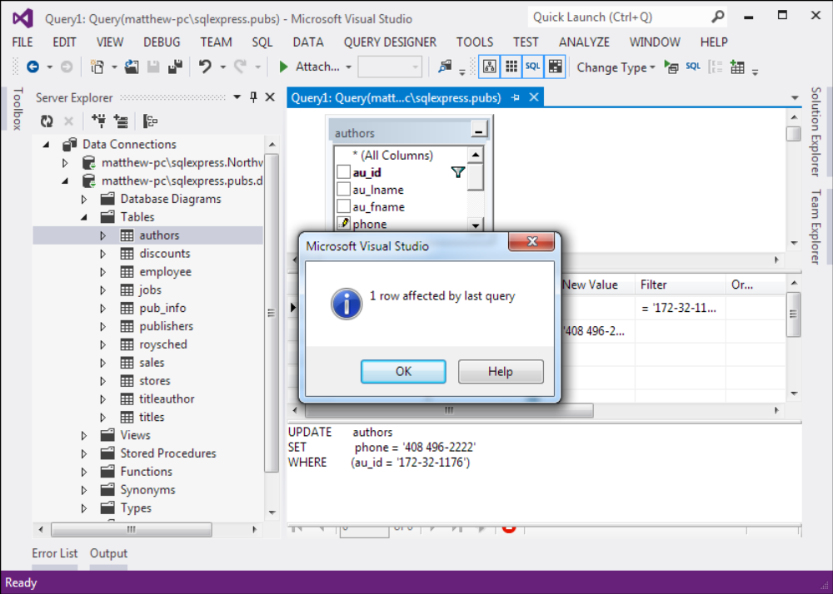
Executing an update query in Visual Studio
Slide <number>

Slide 34
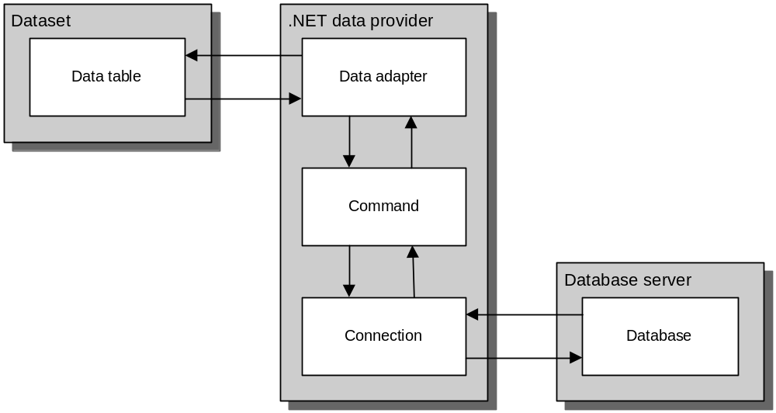
Slide <number>

Slide 35

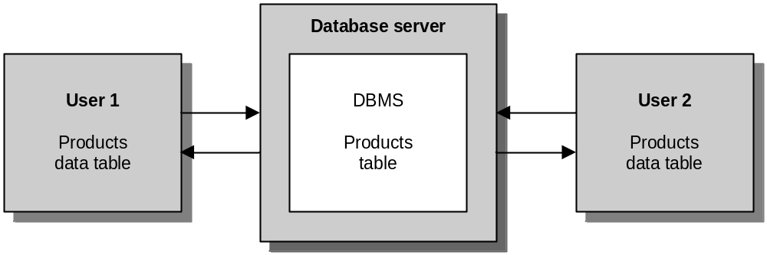
Slide <number>

Slide 36
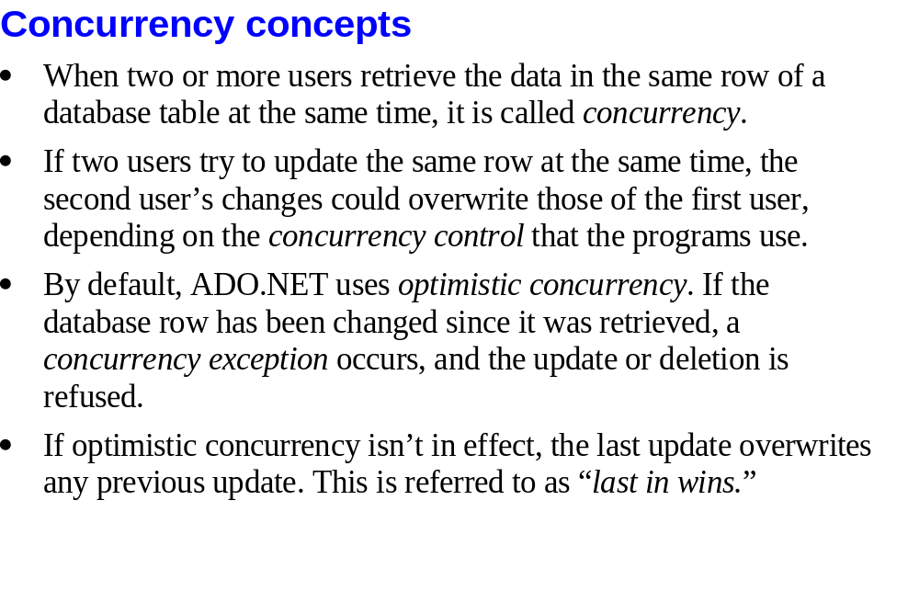
© 2011, Mike Murach & Associates, Inc.
Slide <number>

Slide 37

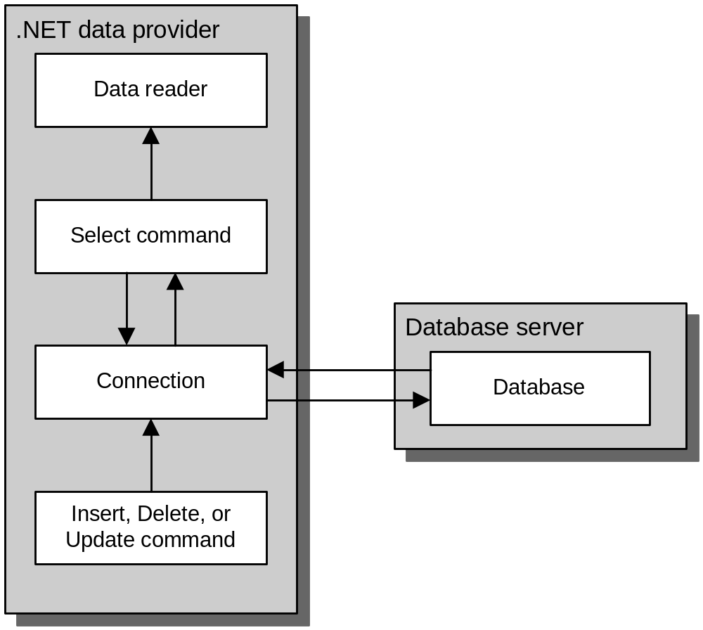
Slide <number>

Slide 38
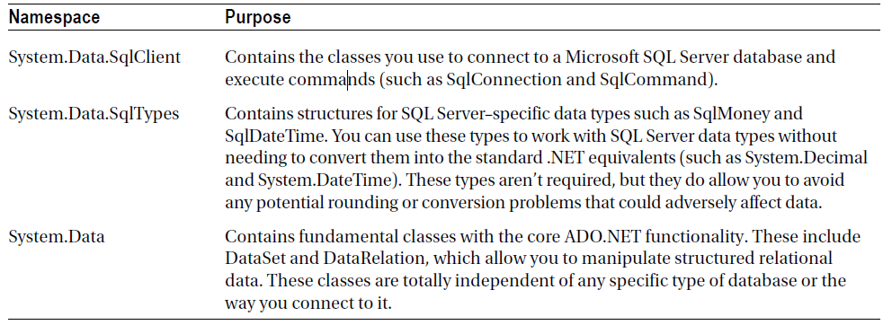
ADO.NET Namespaces for SQL Server Data Access
Slide <number>

Slide 39
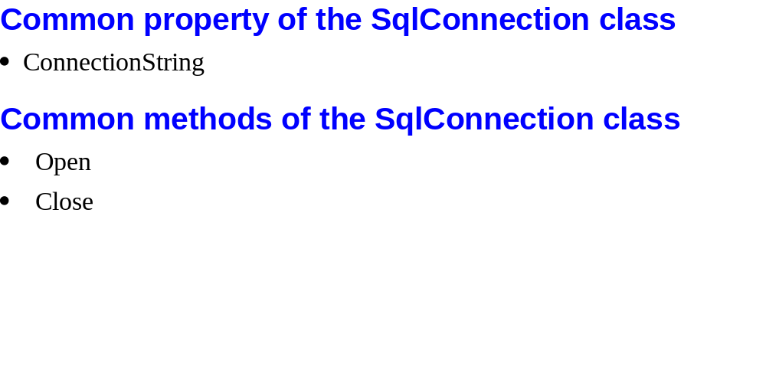
Slide <number>

Slide 40
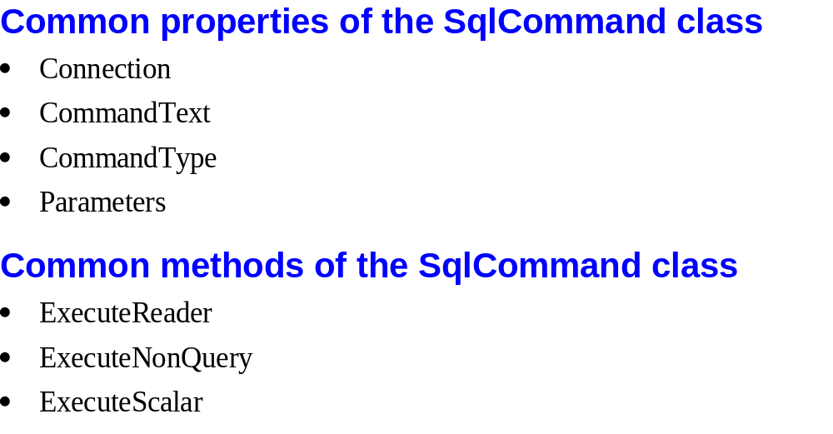
Slide <number>

Slide 41
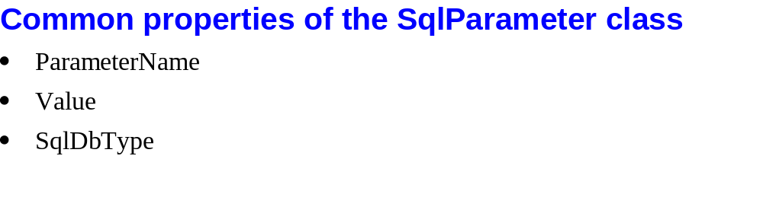
Slide <number>

Slide 42
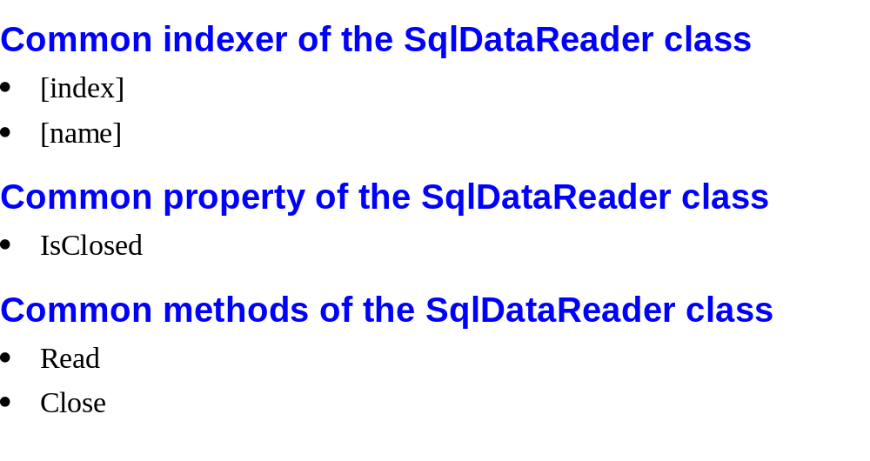
Slide <number>

Slide 43
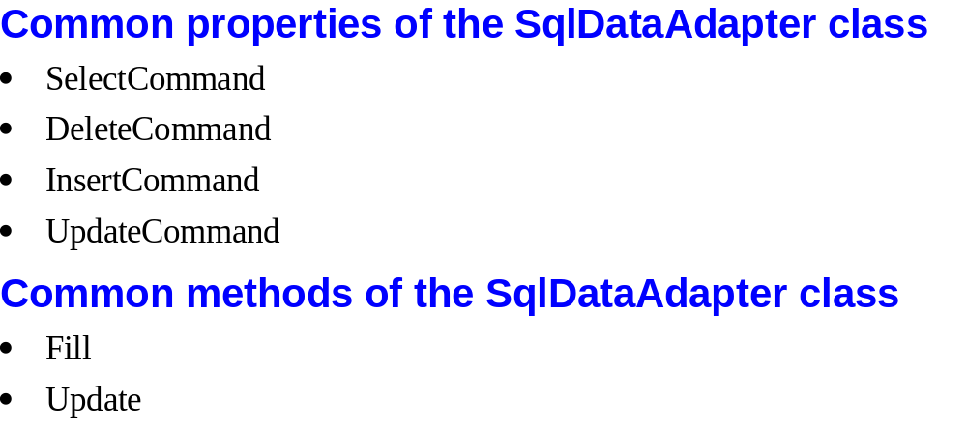
Slide <number>

Slide 44
Using Direct Data Access
To query information with simple data access
  Create Connection, Command, and DataReader objects.
  Use the DataReader to retrieve information from the database, and display it in a control on a web form
  Close your connection.
Slide <number>

Slide 45
Using Direct Data Access
  Send the page to the user. At this point, the information your user sees and the information in the database no longer have any connection, and all the ADO.NET objects have been destroyed.
Slide <number>

Slide 46
Using Direct Data Access
To add or update information
  Create new Connection and Command objects.
  Execute the Command (with the appropriate SQL statement)
Slide <number>

Slide 47
Exploring the Connection String
Distinct pieces of information is separated by semicolons (;) and each is known as a connection string property
Connection string properties | Description
Data source | Indicates the name of the server where the data source is located Eg, localhost, (localdb)\v11.0, localhost\SQLEXPRESS, ServerName\SQLEXPRESS, .\SQLEXPRESS
Slide <number>

Slide 48
Exploring the Connection String
Initial catalog | the name of the database
Integrated security | connect to SQL Server by using the Windows user account. Value assigned is SSPI (which stands for Security Support Provider Interface).
ConnectionTimeout | the number of seconds your code will wait before generating an error if it cannot establish a database connection
Slide <number>

Slide 49
Creating a Connection
should try to hold a connection open for as short a time as possible
write the database code inside a Try/Catch error-handling structure
Make sure to close the connection even if can’t perform all the work
Slide <number>

Slide 50
Creating a Connection
ConnectionString property defines all the information the computer needs to find the data source, log in, and choose an initial database
Slide <number>

Slide 51
Connection string to connect to SQL Server
Dim myConnection As New SqlConnection()
myConnection.ConnectionString = "Data Source = localhost;" & "Initial Catalog = Pubs;Integrated Security = SSPI"
Slide <number>

Slide 52
Connection string to connect to SQL Server Express
Dim myConnection As New SqlConnection()
myConnection.ConnectionString = "Data Source = (localdb)\v11.0;" & "Initial Catalog = Pubs;Integrated Security = SSPI“
[Note: Need to import the namespace System.Data.SqlClient for SqlConnection class.]
Slide <number>

Slide 53
Connect directly to any database file
SQL Server Express has a feature that lets connect directly to any database file (not available in the full edition of SQL Server)
  set the User Instances value to True
  supply the file name of the database you want to connect to with the AttachDBFilename value
Slide <number>

Slide 54
Connect directly to any database file
    myConnection.ConnectionString = "Data Source = (local)\SQLEXPRESS;" & "User Instance = True;AttachDBFilename = |DataDirectory|\Northwind.mdf;" & "Integrated Security = True“
|DataDirectory|. This automatically points to the App_Data folder inside your web application directory
Slide <number>

Slide 55
Storing the Connection String
Store connection strings in the < connectionStrings > section of the web.config file
  <configuration>
  <connectionStrings>
  <add name = "Pubs" connectionString=
  "Data Source = localhost;Initial Catalog = Pubs;Integrated Security = SSPI"/>
  </connectionStrings>
  ...
  </configuration>
Slide <number>

Slide 56
Retrieving the connection string
Need to import the System.Web.Configuration namespace
    Dim connectionString As String = _
    WebConfigurationManager.ConnectionStrings("Pubs").ConnectionString
[Note: Need to import the namespace System.Web.Configuration for the class WebConfigurationManager]
Slide <number>

Slide 57
Making the Connection
' Define the ADO.NET Connection object.
Dim connectionString As String = _
WebConfigurationManager.ConnectionStrings("Pubs").ConnectionString
Dim myConnection As New SqlConnection(connectionString)
Try
' Try to open the connection.
myConnection.Open()
lblInfo.Text = " < b > Server Version:</b > " & myConnection.ServerVersion
lblInfo.Text &= " < br /> < b > Connection Is:</b > " & _
myConnection.State.ToString()
Slide <number>

Slide 58
Making the Connection
Catch err As Exception
' Handle an error by displaying the information.
lblInfo.Text = "Error reading the database."
lblInfo.Text &= err.Message
Finally
' Either way, make sure the connection is properly closed.
' (Even if the connection wasn't opened successfully,
' calling Close() won't cause an error.)
myConnection.Close()
lblInfo.Text &= " < br /> < b > Now Connection Is:</b > "
lblInfo.Text &= myConnection.State.ToString()
End Try
Slide <number>

Slide 59
The Using statement
declares the use of a disposable object for a short period of time
common language runtime will release the object immediately by calling the Dispose() method as soon as the Using block ends
Don’t need to write a Finally block
Slide <number>

Slide 60
The Using statement
' Define the ADO.NET Connection object.
Dim connectionString As String = _
WebConfigurationManager.ConnectionStrings("Pubs").ConnectionString
Dim myConnection As New SqlConnection(connectionString)
Try
Using myConnection
' Try to open the connection.
myConnection.Open()
lblInfo.Text = " < b > Server Version:</b > " & myConnection.ServerVersion
lblInfo.Text &= " < br /> < b > Connection Is:</b > " & _
myConnection.State.ToString()
End Using
Slide <number>

Slide 61
The Using statement
Catch err As Exception
' Handle an error by displaying the information.
lblInfo.Text = "Error reading the database."
lblInfo.Text &= err.Message
End Try
lblInfo.Text &= " < br /> < b > Now Connection Is:</b > "
lblInfo.Text &= myConnection.State.ToString()
Slide <number>

Slide 62
Using the Select Command
An SQL statement that selects the information you want
A Command object that executes the SQL statement
To ensure good database performance, you should open your connection just before you execute your command and close it as soon as the command is finished
A DataReader or DataSet object to access the retrieved records
Slide <number>

Slide 63
Using the Select Command
Dim myCommand As New SqlCommand()
myCommand.Connection = myConnection
myCommand.CommandText = "SELECT * FROM Authors ORDER BY au_lname“
Or
Dim myCommand As New SqlCommand(_
"SELECT * FROM Authors ORDER BY au_lname ", myConnection)
Slide <number>

Slide 64
Using the DataReader
uses a live connection
It supports fast-forward-only read-only access
provides better performance than the DataSet
should always be the first choice for direct data access
use the ExecuteReader() method of the command object
Slide <number>

Slide 65
Using the DataReader
Use the ExecuteReader() method of the command object to create a DataReader
  ' You don't need the new keyword, as the Command will create the DataReader.
  Dim myReader As SqlDataReader
  myReader = myCommand.ExecuteReader()
retrieve a single row at a time by using the Read() method
  myReader.Read() ' The first row in the result set is now available.
access the values in the current row by using the corresponding field names
  lstNames.Items.Add(myReader("au_lname") & ", " & myReader("au_fname"))
Slide <number>

Slide 66
Using the DataReader
To move to the next row, use the Read() method again
  Returns either True (row of information has
  been successfully retrieved) or False (attempted to read past the end of the result set)
There is no way to move backward to a previous row
Slide <number>

Slide 67
Using the DataReader
close the DataReader and Connection
    myReader.Close()
    myConnection.Close()
Slide <number>

Slide 68
Updating Data
use the Command object
use one of three SQL commands: Update, Insert, or Delete
execute the command with the ExecuteNonQuery() method
This method returns the number of rows that were affected
Slide <number>

Slide 69
Update, Insert, or Delete
Demo : AuthorManager.aspx
Slide <number>

Slide 70
Creating More Robust Commands
Drawbacks of using a dynamically pasted-together SQL string:-
  Users may accidentally enter characters that will affect your SQL statement.
  Users might deliberately enter characters that will affect your SQL statement
Slide <number>

Slide 71
Creating More Robust Commands
Solutions:-
  sanitize your input by doubling all apostrophes in the user input (in other words, replace ‘ with “)
    Eg. Dim authorID As String = txtID.Text.Replace("'", "''")
  use a parameterized command
    Eg.
    SELECT * FROM Customers WHERE CustomerID = @CustomerID
    Need to add a Parameter object for each parameter in the Command.Parameters collection
Slide <number>

Slide 72
Example
Dim insertSQL As String
insertSQL = "INSERT INTO Authors ("
insertSQL &= "au_id, au_fname, au_lname, "
insertSQL &= "phone, address, city, state, zip, contract) "
insertSQL &= "VALUES ("
insertSQL &= "@au_id, @au_fname, @au_lname, "
insertSQL &= "@phone, @address, @city, @state, @zip, @contract)“
…
Slide <number>

Slide 73
Example
Dim con As New SqlConnection(connectionString)
Dim cmd As New SqlCommand(insertSQL, con)
' Add the parameters.
cmd.Parameters.AddWithValue("@au_id", txtID.Text)
cmd.Parameters.AddWithValue("@au_fname", txtFirstName.Text)
cmd.Parameters.AddWithValue("@au_lname", txtLastName.Text)
cmd.Parameters.AddWithValue("@phone", txtPhone.Text)
cmd.Parameters.AddWithValue("@address", txtAddress.Text)
cmd.Parameters.AddWithValue("@city", txtCity.Text)
cmd.Parameters.AddWithValue("@state", txtState.Text)
cmd.Parameters.AddWithValue("@zip", txtZip.Text)
cmd.Parameters.AddWithValue("@contract", chkContract.Checked)
Slide <number>

Slide 74
Using Disconnected Data Access
Use the DataSet to keep a copy of the data in memory
Reasons to use the DataSet to hold onto data in memory:-
  need to do something time-consuming with the data
  Need to use ASP.NET data binding to fill a web control (such as a GridView)
Slide <number>

Slide 75
Using Disconnected Data Access
  Need to navigate backward and forward through the data
  Need to navigate from one table to another
  Need to save the data to a file for later use (using WriteXml() and ReadXml())
  need a convenient package to send data from one component to another
  Need to store some data so it can be used for future requests
Slide <number>

Slide 76
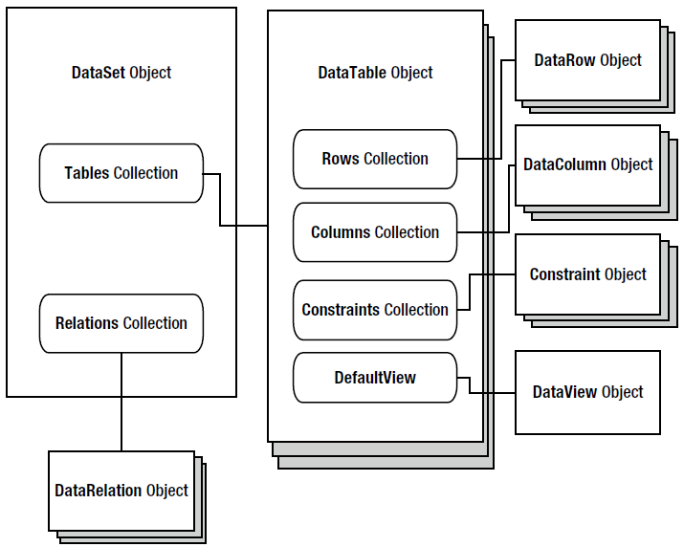
The DataSet family of objects
Slide <number>

Slide 77
FillAuthorList() method
Private Sub FillAuthorList()
lstAuthor.Items.Clear()
' Define ADO.NET objects.
Dim selectSQL As String
selectSQL = "SELECT au_lname, au_fname, au_id FROM Authors"
Dim con As New SqlConnection(connectionString)
Dim cmd As New SqlCommand(selectSQL, con)
Dim adapter As New SqlDataAdapter(cmd)
Dim dsPubs As New DataSet()
Slide <number>

Slide 78
FillAuthorList() method
' Try to open database and read information.
Try
con.Open()
' All the information in transferred with one command.
' This command creates a new DataTable (named Authors)
' inside the DataSet.
adapter.Fill(dsPubs, "Authors")
Catch err As Exception
lblResults.Text = "Error reading list of names. "
lblResults.Text &= err.Message
Finally
con.Close()
End Try
Slide <number>

Slide 79
FillAuthorList() method
For Each row As DataRow In dsPubs.Tables("Authors").Rows
Dim newItem As New ListItem()
newItem.Text = row("au_lname") & ", " & _
row("au_fname")
newItem.Value = row("au_id").ToString()
lstAuthor.Items.Add(newItem)
Next
End Sub
[Need to import System.Data for DatSet class.]
Slide <number>

Slide 80
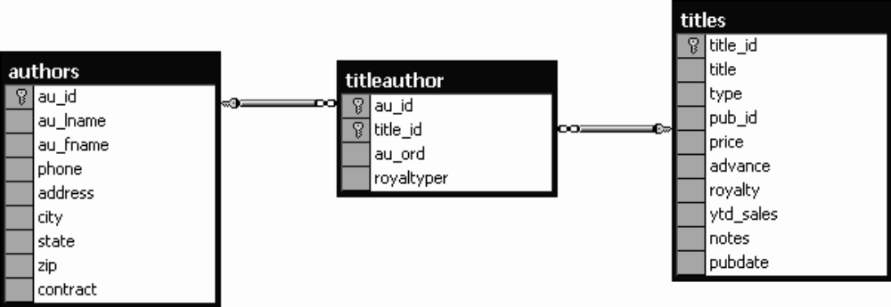
Selecting Multiple Tables
Slide <number>

Slide 81
Selecting Multiple Tables
Creating the standard ADO.NET data access objects
  ' Define the ADO.NET objects.
  Dim connectionString As String = _
  WebConfigurationManager.ConnectionStrings("Pubs").ConnectionString
  Dim con As New SqlConnection(connectionString)
  Dim selectSQL As String = "SELECT au_lname, au_fname, au_id FROM Authors"
  Dim cmd As New SqlCommand(selectSQL, con)
  Dim adapter As New SqlDataAdapter(cmd)
  Dim dsPubs As New DataSet()
Slide <number>

Slide 82
Selecting Multiple Tables
Pulling the information from all three tables and placing them the DataSet
  Try
  con.Open()
  adapter.Fill(dsPubs, "Authors")
  ' This command is still linked to the data adapter.
  cmd.CommandText = "SELECT au_id, title_id FROM TitleAuthor"
  adapter.Fill(dsPubs, "TitleAuthor")
  ' This command is still linked to the data adapter.
  cmd.CommandText = "SELECT title_id, title FROM Titles"
  adapter.Fill(dsPubs, "Titles")
Slide <number>

Slide 83
Selecting Multiple Tables
  Catch err As Exception
  lblList.Text = "Error reading list of names. "
  lblList.Text & = err.Message
  Finally
  con.Close()
  End Try
Slide <number>

Slide 84
Defining Relationships
To create a DataRelation, need to:-
  specify the linked fields from two tables (The first field is the parent, and the second field is the child)
  Dim Titles_TitleAuthor As New DataRelation("Titles_TitleAuthor", _
  dsPubs.Tables("Titles").Columns("title_id"), _
  dsPubs.Tables("TitleAuthor").Columns("title_id"))
  Dim Authors_TitleAuthor As New DataRelation("Authors_TitleAuthor", _
  dsPubs.Tables("Authors").Columns("au_id"), _
  dsPubs.Tables("TitleAuthor").Columns("au_id"))
Slide <number>

Slide 85
Add the relation to the DataSet
  dsPubs.Relations.Add(Titles_TitleAuthor)
  dsPubs.Relations.Add(Authors_TitleAuthor)
Slide <number>

Slide 86
Using the DataRelation objects to branch to the other linked tables
Select the first record from the Authors table.
Using the Authors_TitleAuthor relationship, find the child records that correspond to this author. To do so, you call the DataRow.GetChildRows() method, and pass in the DataRelationship object that models the relationship between the Authors and TitleAuthor table.
For each matching record in TitleAuthor, look up the corresponding Title record to get the full text title. To do so, you call the DataRow.GetParentRows() method and pass in the DataRelationship object that connects the TitleAuthor and Titles table.
Move to the next Author record and repeat the process.
Slide <number>

Slide 87
Using the DataRelation objects to branch to the other linked tables
For Each rowAuthor As DataRow In dsPubs.Tables("Authors").Rows
lblList.Text &= " < br /> < b > " & rowAuthor("au_fname")
lblList.Text &= " " & rowAuthor("au_lname") & "</b > <br />"
For Each rowTitleAuthor As DataRow In _
rowAuthor.GetChildRows(Authors_TitleAuthor)
Dim rowTitle As DataRow
rowTitle = rowTitleAuthor.GetParentRows(Titles_TitleAuthor)(0)
lblList.Text &= "&nbsp;&nbsp;"
lblList.Text &= rowTitle("title") & " < br />"
Next
Next
Slide <number>

